Slide 1
Department of Applied Mathematics and Computational Sciences
II Sem M.Sc. Cyber Security
Discrete Structures
Dr. V. Suresh kumar

Slide 2
Euler and Hamilton Paths

Slide 3
Introduction
Can we travel along the edges of a graph starting at a vertex and returning to it by traversing each edge of the graph exactly once?
Can we travel along the edges of a graph starting at a vertex and returning to it while visiting each vertex of the graph exactly once?
The first question, can be easily answered simply by examining the degrees of the vertices of the graph
While the second question is quite difficult to solve for most graphs

Slide 4
Euler Paths and Circuits

Slide 5


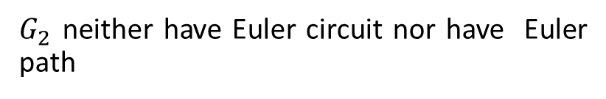
DEFINITION
An Euler circuit in a graph G is a simple circuit containing every edge of G. An Euler path in G is a simple path containing every edge of G.
EXAMPLE 1
Which of the undirected graphs given below have an Euler circuit? Of those that do not, which have an Euler path?
The graph $G_{1}$ has an Euler circuit, $a, e, c, d, e, b, a$
However, $G_{3}$ has an Euler path, $a, c, d, e, b, d, a, b$.
$G_{2}$ neither have Euler circuit nor have Euler path
$$a, d, b,e, d, c, a, b$$

Slide 6
THEOREM
A connected multi-graph with at least two vertices has an Euler circuit if and only if each of its vertices has even degree.
THEOREM
A connected multi-graph has an Euler path but not an Euler circuit if and only if it has exactly two vertices of odd degree.
EXAMPLE
Which of the undirected graphs given below have an Euler circuit? Of those that do not, which have an Euler path?

Slide 7
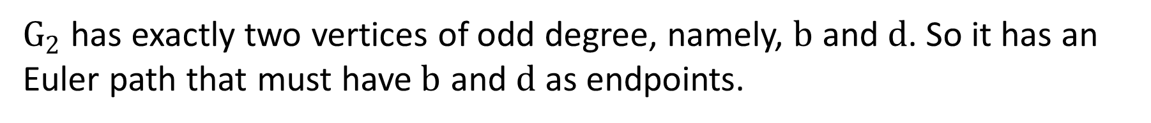
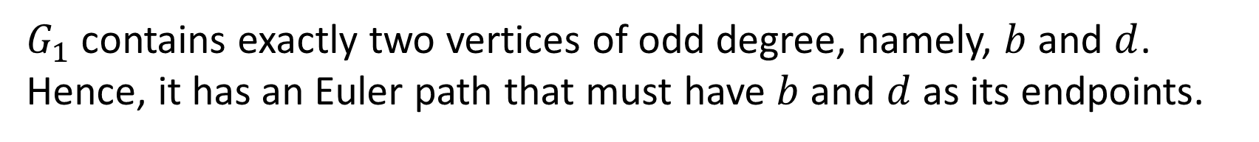
Answers
$G_{1}$ contains exactly two vertices of odd degree, namely, $b$ and $d$. Hence, it has an Euler path that must have $b$ and $d$ as its endpoints.
$G_{2}$ has exactly two vertices of odd degree, namely, $b$ and $d$. So it has an Euler path that must have$b$ and $d$ as endpoints.
$G_{3}$ has no Euler path because it has six vertices of odd degree.

Slide 8
Hamilton Paths and Circuits

Slide 9
DEFINITIONS
A simple path in a graph G that passes through every vertex exactly once is called a Hamilton path
A simple circuit in a graph G that passes through every vertex exactly once is called a Hamilton circuit

Slide 10

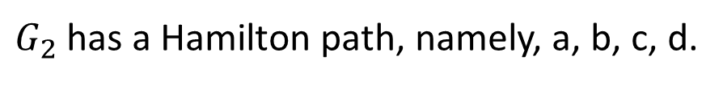

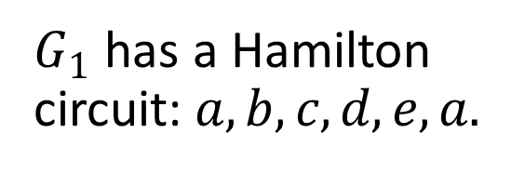
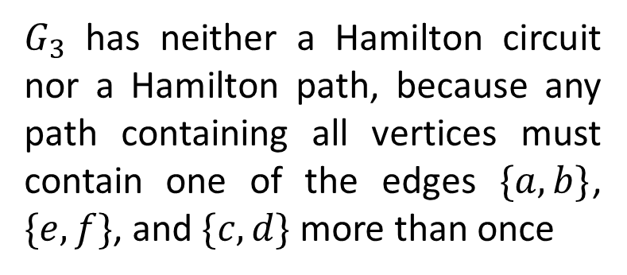
EXAMPLE
Which of the simple graphs given below have a Hamilton circuit or, if not, a Hamilton path?
$G_{1}$ has a Hamilton circuit:$a, b, c, d, e, a.$
$G_{3}$ has neither a Hamilton circuit nor a Hamilton path, because any path containing all vertices must contain one of the edges $\{a,b\}$, $\{e,f\}$, and $\{c, d\}$ more than once
There is no Hamilton circuit in $G_{2}$
Note that any circuit containing every vertex must contain the edge $\{a, b\}$ twice
$G_{2}$ has a Hamilton path, namely, a, b, c, d.

Slide 11


